Slide 1
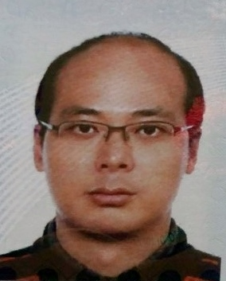
«Enhancing Public Sector’s PPP Capacity: Korea’s Experience»
Seungbeum Rho
Head, Global Cooperation Team, Public and Private Infrastructure Investment Management Center(PIMAC), Korea Development Institute(KDI)
Speaker of Round table «Developing professional competencies in the field of PPP»
II INVESTMENT PPP FORUM
«PPP IN THE FACE OF THE PANDEMIC: CHALLENGES
AND OPPORTUNITIES» »
Online Forum PPP

Slide 2
Contents
Performance of PPPs in Korea
Role of PIMAC in PPPs
Enhancing Public Sector’s PPP Capacity
Conclusion
2

Slide 3
Part-01
Performance of PPPs in Korea

Slide 4
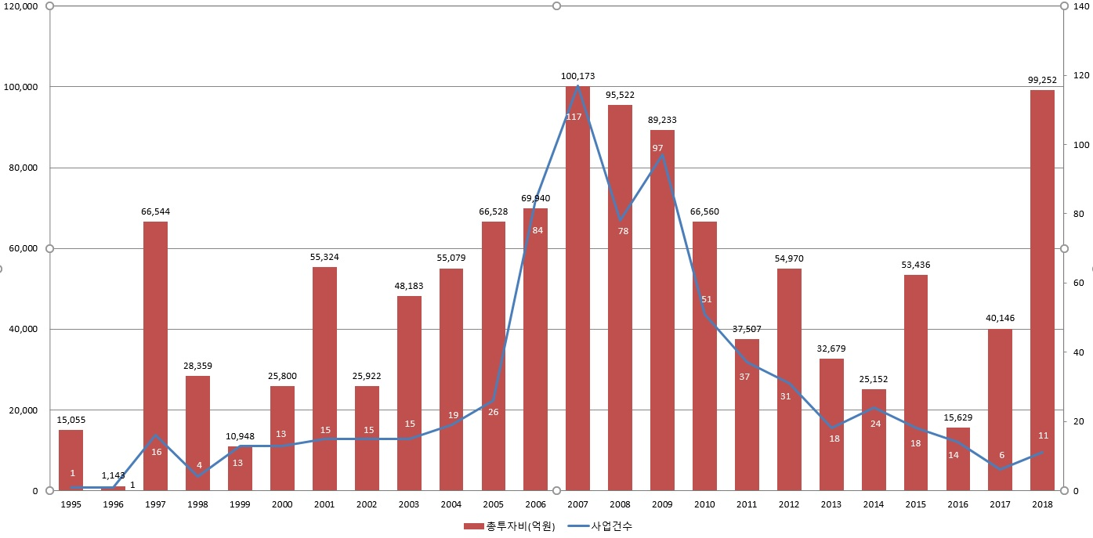
Performance of PPPs in Korea (1)
The number of PPP projects and the investment amount increased from 1994 to 2007.
(unit: 100 million KRW)
(number of projects)
Source: 2018 KDI Public and Private Infrastructure Investment Management Center Annual Report, KDI July. 2019
4
Notes:
This slide shows the number of PPP projects and the investment amount from 1995 to 2018.
The blue line graph represents the number of PPP projects, and the bar graph represents the investment amount.
As you see on the slide, PPP investment increased from 1995 to 2007. As I mentioned, the government policies to promote PPPs, such as the MRG system, had a considerable impact. The adoption of BTL scheme in 2005 also affected investment performance greatly.
From 2008 to 2016, the amount of investment and the number of projects decreased. This trend can be seen as being affected by the government's policy shift to reduce financial burdens. The government abolished the MRG system in 2009 and strengthened the regulation of the PPP projects. And the 2008 global financial crisis is also believed to have influenced adversely.
In 2015, the government reversed its policy direction and took measures to revitalize the PPP market.
The core of the policy was introducing ‘new risk-sharing system’. Currently, we are expecting the new policy will have a substantial effect on the PPP market.

Slide 5
Performance of PPPs in Korea (2)
The number of PPP projects and total investment
(unit: 100 million KRW)
 | Solicited |  | Unsolicited
 | No. of Projects | Total Investment Amount | No. of Projects | Total Investment Amount
Education | 239 | 103,705 | - | -
Environment | 131 | 84,892 | 62 | 58,696
Defense | 81 | 61,160 | - | -
Road | 20 | 142,316 | 47 | 317,886
Parking Lot | 24 | 2,505 | 4 | 871
Culture and Tourism | 34 | 12,663 | 6 | 4,835
Welfare | 15 | 5,550 | - | -
Harbor | 12 | 61,231 | 5 | 11,204
Airport | 13 | 7,759 | 1 | 502
Railroad | 11 | 169,977 | 7 | 115,130
Distribution | 4 | 10,352 | 2 | 5,091
ICT | 4 | 2,092 | 1 | 444
housing | 1 | 223 | - | -
Total | 589 | 664,426 | 135 | 514,659
Source: 2018 KDI Public and Private Infrastructure Investment Management Center Annual Report, KDI July. 2019
5
Notes:
The table on this slide shows the total number of PPP projects and the total amount of investment. From 1994 to 2018, about US$ 99.6 billion was invested, and 724 projects were implemented. In terms of the number of projects, education facilities rank at the top, followed by environment facilities. In terms of the amount of investment, roads rank at the top, followed by railroads.

Slide 6
Performance of PPPs in Korea (3) PPP’s Contribution to Fiscal Budget
PPP has undertaken a considerable part of public investment, as the ratio of infrastructure investment through PPP ranges from 4% to 19.5%.
The promotion of PPP has helped ease constraints on the government’s financial resources, channeling the scarce resources into other demand areas.
(Trillion KRW)
Note: PPP Investment = executed amounts of BTO projects and BTL railroad projects
Source: PIMAC Internal data
6
Notes:
As you can see from the graph, from 1999 to 2018, the ratio of infrastructure investment through PPP ranges from 4% to 19.5%.
The promotion of PPP has helped ease the financial constraints of the government, enabling a more efficient resource allocation.

Slide 7
Part-02
Role of PIMAC in PPPs

Slide 8
History of PIMAC
PIMAC (Public and Private Infrastructure Investment Management Center), is an affiliated body of KDI (Korea Development Institute).
KDI, founded in 1971, has served as a leading research institute over the past four decades.
PIMAC is a statutory organization established through the merger of PIMA and PICKO by the amendment of ‘The PPP Act’ in January 2005.
The PIMA (Public Investment Management Center) of KDI, founded in Jan. 2000, centered on research and management of public investment projects.
The PICKO (Private Infrastructure Investment Center of Korea) of KRIHS (Korea Research Institute for Human Settlements), founded in April 1999, centered on research and management of PPP projects.
8
Notes:
PIMAC is an affiliated body of Korea Development Institute (KDI)
PIMAC was established as a merger of Public Investment Management Center (PIMA) at KDI and Private Infrastructure Investment Center of Korea (PICKO) at Korea Research Institute for Human Settlement (KRIHS) with the amendment of the Act on Public-Private Partnerships in Infrastructure in January 2005.

Slide 9
Role of PIMAC in PPPs
Public Sector Players
Min. of Economy & Finance
PPP Review Committee
Policy & Coordination
Competent Authority
Procuring Ministries
Local Gov’ts
Min. of Land, Infrastructure, and Transport
Min. of Culture, Sports & Tourism
Min. of Education
Min. of Environment
Min. of Health & Welfare
Min. of Natl. Defense, etc.
Evaluating Projects
Technical Assistance
Policy Advice & Research
PIMAC
9
Notes:
PIMAC is an affiliated body of Korea Development Institute (KDI)
PIMAC was established as a merger of Public Investment Management Center (PIMA) at KDI and Private Infrastructure Investment Center of Korea (PICKO) at Korea Research Institute for Human Settlement (KRIHS) with the amendment of the Act on Public-Private Partnerships in Infrastructure in January 2005.

Slide 10
Part-03
Enhancing Public Sector’s PPP Capacity
Notes:
In this part, I’d like to explain the roles of PIMAC in PPP projects.

Slide 11
Public Sector’s Capacity : Why does it matter?
PPP involves
Estimating long-term demand and cost
Managing a wide range of stakeholders
Complicated project structure
Project financing
A number of legal and financial issues
In most cases, the private sector’s capacity is much stronger than that of the public sector.
Public sector agencies often lack sufficient capacity.
There is a wide capacity gap between central ministries and local governments.
Hiring external experts can be a complementary measure. However, it may have several limitations.
11

Slide 12
Enhancing Public Sector’s Capacity in Korea
Ministry of Economy and Finance
Formulates clear and consistent PPP policies
Provides guidance
PIMAC
Publishes detailed guidelines and standardized documents
Reviews project proposals, draft RFPs, and draft concession agreements
Assists in bidding processes and negotiations
Reviews refinancing plans and restructuring plans
Provides consultations for contracting authorities
Provides consultations for the PPP dispute mediation committee
Provides capacity-building programs
Manages PPP database
12

Slide 13
PIMAC : Areas of Expertise
Areas of Expertise | Head Count
Economics/Statistics | 26
Business/Accounting | 12
Engineering (civil, architecture, environment, etc.) | 23
Urban planning/Urban engineering/Transport | 13
International relations/International cooperation | 5
Law | 5
Others (Tourism, etc.) | 7
Administration/Intern | 7
Total | 98
*As of March 2018
Notes:
Let me show the organization of PIMAC.
As you can see in this slide, PIMAC is divided into three different divisions, which are 1) public investment evaluation division, 2) public-private partnerships division, and 3) policy and research division.
- Public Investment Evaluation Division carries out execution and management of publicly financed infrastructure projects
- Policy and Research Division is where policy research is conducted independently of actual project implementation
- Public-Private Partnership(PPP) Division is in charge of PPP projects.

Slide 14
Implementation Guidelines by PIMAC
Implementations in Transparency, Objectivity and Consistency as well as Professional expertise are key elements.
Guidelines for Value for Money (VFM) test
Guidelines for RFP preparation
Guidelines for Tender Evaluation
Guidelines for Standard Concession Agreement
Guidelines for Standard Output Specification by facility
Guidelines for Refinancing
PIMAC has developed PPP Implementation Guidelines and updated them reflecting changes and market conditions.
14

Slide 15
Capacity-Building Programs (1)
Basic course for public sector practitioners
introduction of PPP policy, PPP laws and institutional settings, implementation procedure, guarantees for PPPs
In 2019, 284 people attended.
Basic course for private sector practitioners
introduction of PPP policy, PPP laws and institutional settings, implementation procedure, guarantees for PPPs
In 2019, 91 people attended.

Slide 16
Capacity-Building Programs (2)
PPP intensive course
Introduction of PPP policy, implementation procedure, feasibility assessment and VFM test, drafting RFPs and awarding preferred bidder, refinancing, dispute resolution
In 2019, 45 people attended.
PPP finance course
introduction of PPP finance, practicing with financial model, refinancing and restructuring, tax issues
In 2019, 47 people attended.

Slide 17
Performance of PPP Project Assessment and Review by PIMAC
Process |  | ’99 | ‘00 | ‘01 | ‘02 | ‘03 | ‘04 | ‘05 | ‘06 | ‘07 | ‘08 | ‘09 | ‘10 | ‘11 | ‘12 | ‘13 | ‘14 | ’15 | ’16 | ’17 | ’18
Assessment of project at ex-ante
1 | VFM test, review of project proposals | 9 | 31 | 29 | 22 | 43 | 19 | 15 | 13 | 23 | 25 | 107 | 35 | 27 | 30 | 24 | 26 | 20 | 15 | 21 | 40
2 | Review of Announcement of Request for Alternate Proposals/Requests for Proposals | 7 | 7 | 9 | 7 | 12 | 11 | 48 | 57 | 62 | 42 | 42 | 35 | 18 | 14 | 12 | 11 | 10 | 8 | 4 | 8
3 | Evaluation on behalf of competent authority of project proposals to select preferred bidder | 1 | 2 | 8 | 7 | - | 7 | 16 | 8 | 17 | 5 | 1 | 7 | 4 | 2 | - | - | 1 | 1 | 1 | -
4 | Negotiation on behalf of competent authority for contract award and other Consultations | 3 | 32 | 23 | 25 | 29 | 20 | 6 | 8 | 6 | 8 | 4 | 4 | 3 | 3 | - | 4 | - | 2 | 1 | -
5 | Review of draft concession agreement | 3 | 5 | 3 | 2 | 2 | 7 | 2 | 41 | 78 | 80 | 72 | 45 | 25 | 20 | 13 | 16 | 16 | 11 | 9 | 7
Review and consultation at ex-post
6 | Review/consultation of plans for refinancing | - | - | - | - | - | - | - | - | 4 | 12 | 14 | 9 | 16 | 4 | 11 | 6 | 9 | 16 | 13 | 11
7 | Alteration of Project Conditions | - | - | - | - | - | - | - | - | - | - | - | - | - | 2 | - | 2 | 4 | 6 | - | 3
8 | Consultation on dispute resolution | - | - | - | - | - | - | - | - | - | - | - | - | - | 3 | 1 | 2 | 2 | - | - | -
Notes:
Let me show the organization of PIMAC.
As you can see in this slide, PIMAC is divided into three different divisions, which are 1) public investment evaluation division, 2) public-private partnerships division, and 3) policy and research division.
- Public Investment Evaluation Division carries out execution and management of publicly financed infrastructure projects
- Policy and Research Division is where policy research is conducted independently of actual project implementation
- Public-Private Partnership(PPP) Division is in charge of PPP projects.

Slide 18
Major International Capacity Building Programs
Capacity Building Programs | Date
Asia Public-Private Partnership Practitioners’ Network (APN) Conference 2016, 2017, 2018, 2019 | November 5-7, 2019 November 5-8, 2018 November 29-December 1, 2017 November 30-December 2, 2016
PPP capacity building workshop for the region of Central and South America | September 10-14, 2018 April 3-7, 2017
Capacity Development for PPP Infrastructure Development in Bangladesh | April 6-10, 2015
Public Investment through PPP for Economic Development in Mongolia | March 11-12, 2015
Training for China PPP Center (Ministry of Finance) Senior Government Officials | November 18, 2014
PPP in Kazakhstan: Strategy and Perspectives Conference | November 1-4, 2014
Asia Public-Private Partnership Practitioners’ Network (APN) 2013: Heads of PPP Unit Forum | December 10-11, 2013
Training and Consultancy for Capacity Building on Public Investment Management for Economic Development in Azerbaijan | February 4-7, 2013
Asia Public-Private Partnership Practitioners’ Network (APN) Training 2010, 2011, 2012 | November 5-9, 2012 October 17-21, 2011 October 4-8, 2010
Practical Aspects of PPP Mechanism during Implementation of Investment Projects in Kazakhstan | July 24-26, 2012
ADB TA-THAILAND: Mainstreaming Public-Private Partnerships | August 1-11, 2011
Public-Private Partnerships for Infrastructure Development in Bangladesh | July 4-8, 2011
Public Investment Management for Economic Development in Mongolia | June 14-18, 2010
Public-Private Partnerships for Infrastructure Development in Thailand | September 28-29, 2009
18

Slide 19
Part-04
Conclusion

Slide 20
Conclusion
For successful PPPs, PPP capacity of both the private sector and public sector matters.
In most cases, the private sector entities have stronger capacity than the public sector. So, enhancing the public sector’s PPP capacity is significant for proper management and supervision of PPP projects.
The ministry in charge of PPP policy, PPP agency, and contracting authorities need to work closely to enhance the public sector’s PPP capacity.
Establishing institutional settings for effective and efficient cooperation
Providing capacity building programs and opportunities for sharing knowledge and experience
20

Slide 21
THANK YOU!

